Slide 1
Intro to MongoDB
Lesson 17.1

Slide 2
Agenda
Tuesday
Thursday
Saturday
NoSQL
MongoDB
Overview
CRUD operations
Basic functions
Robo 3T (GUI)
Mongoose
Schema
Custom Methods
Relationships between collections
IndexedDB
Cookies
Cursors
Notes:
Robo 3T is like MySQL Workbench

Slide 3
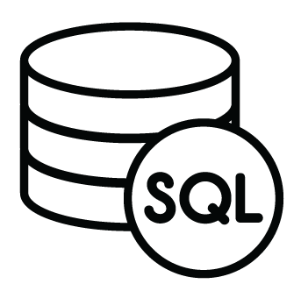
Relational Databases (SQL)
ID | Title | Author | Published
1 | The History of Blah | Blah Matic | 2010
2 | The Chronicles of Blahrnia | Sir Blahston | 2011
3 | Love in the Time of Blah | Gabriel Garcia Blah | 2013
SQL relies on joins to combine relevant data.
Author | Email | Phone Number
Blah Matic | blahston@gmail.com | 911-546-5454
Sir Blahston | blahby@gmail.com | 911-544-5112
Gabriel Garcia Blah | blahby231@gmail.com | 125-215-5645
Masters of MongoDB

Slide 4

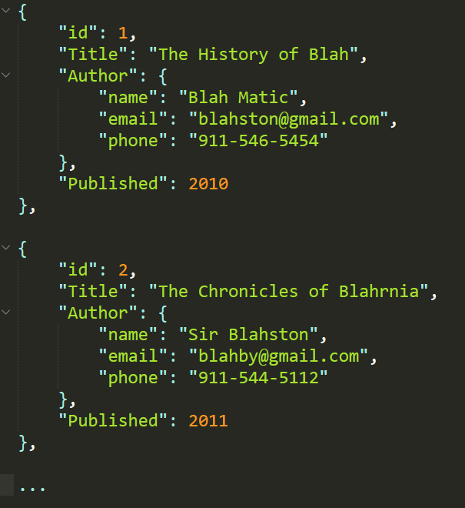
Document Database (NoSQL)
NoSQL databases, on the other hand, are often effectively collection of JSON blobs
They excel at mixed data formats and are easy to implement
Masters of MongoDB
Notes:
Came about from Web 2.0 movement – Social Web (user-generated content)
Fit well for big data and real-time apps
Horizontal scaling (SQL is good at vertical scaling)
Example – more floors in a building or more houses
Supports SQL-like languages but not SQL itself
Flexible document based storage
Some operations can be faster
ACID – atomic, consistent, isolation, durable
Compromises the “C” from ACID - Instead there is eventual consistency

Slide 5
What Is MongoDB?
MongoDB is a very popular NoSQL database.
It uses a document-oriented model as opposed to a table-based relational model (SQL).
MongoDB stores data in BSON format (effectively, binary compressed JSONs).
MongoDB has tons of drivers and packages for connecting to Node, C++, Java, etc.
Masters of MongoDB

Slide 6
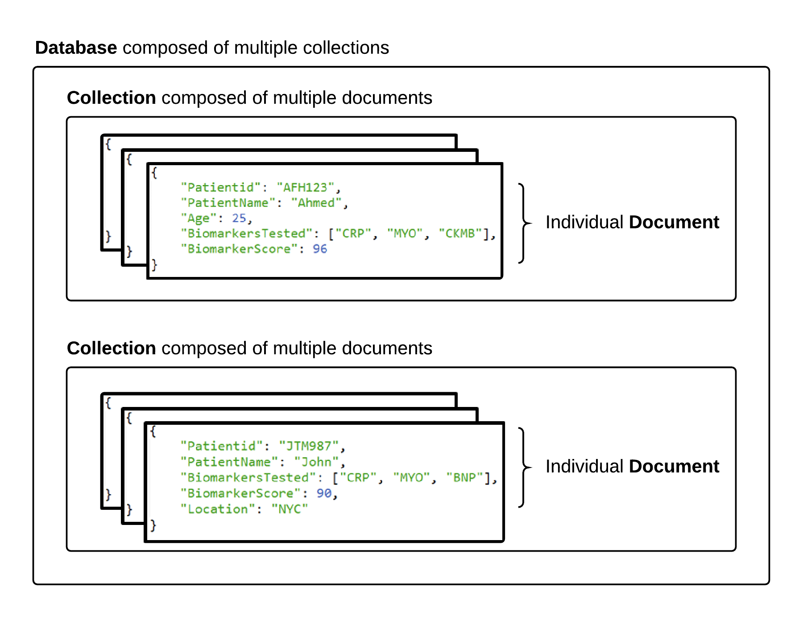
MongoDB Storage
Masters of MongoDB

Slide 7
MongoDB Terms
There is largely a 1-1 correlation between SQL and NoSQL
SQL Term | NoSQL Term
Database | Database
Table | Collection
Record / Row | Document
Column | Field
Masters of MongoDB

